Slide 1




For Government
GSA Contract Number
DUNS Number
Cage Code
47QTCA23D00DH
015234069
6CF97

Slide 2


About Us
Ortus Solutions is a leading innovator in software development, dedicated to delivering cutting-edge web-based solutions. With a strong commitment to quality and innovation, we provide expert services in modern application development.
GSA Contract Number
47QTCA23D00DH
Formed 2006, Ortus Solutions is an established professional software development firm.
8a-certified small business with a proven track record of excellence.
Specialized in mobile and web application design, development and deployment.
Creators of 350+ web development tools powering application across the world.
Open Source Software publishers with a focus on empowering business and developers alike

Slide 3

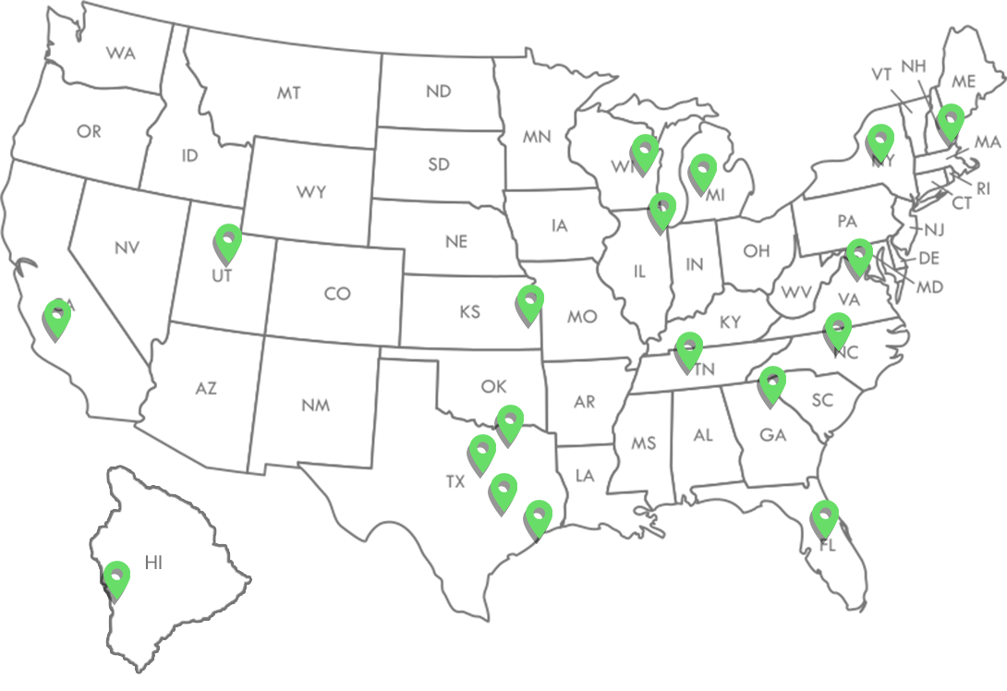
Locations
Houston, TX
West Bend, WI
Reston, VA
Bakersfield, CA
Grand Rapids, MI
Antioch, TN
Holland Patent, NY
Saratoga Springs, UT
Capitan Cook, HI
Kansas City, MO
Fairfax, VA
Randleman, NC
Andover, MA
Mckinney, TX
Spring, TX
Waxahachie, TX
Plainfield, IL
Martinez, GA
Davenport, FL

Slide 4
Core Competencies

Slide 5

Core Competencies
Modernization and Digital Transformation
Expert development and modernization of legacy applications using ColdBox MVC and the BoxLang JVM Language, enhancing performance and maintainability.
Tailored solutions for secure, scalable, and efficient web-based government applications.

Slide 6

Core Competencies
Proprietary JVM Programming Language
Optimized for high-performance, mission-critical applications.
Comprehensive support for migration from legacy languages to BoxLang.
Increased system reliability and reduced operational costs.
Drop-in replacement for Adobe ColdFusion
Multi-Runtime: CLI Applications, Lambdas, Web, Mobile, and more.
www.boxlang.io

Slide 7
Core Competencies
Custom Software Development
End-to-end web application development using modern frameworks (ColdBox MVC, Vue.js, Quasar).
Multi-tenant and multi-region solutions for government services and data management.
Robust API development and integration, including secure and compliant data exchange.

Slide 8
Core Competencies
DevOps and Infrastructure Automation
Automated CI/CD pipelines for rapid, reliable deployment.
Infrastructure management on Digital Ocean, AWS, Azure, and other cloud environments.
Scalable containerized applications leveraging Docker and Kubernetes.

Slide 9
Core Competencies
Cybersecurity and Compliance
Adherence to government standards (e.g., FISMA, NIST).
Secure coding practices and vulnerability assessments to safeguard government data.
Role-based access control (RBAC) and audit logging for high-security environments.

Slide 10
Core Competencies
Training and Technical Support
Comprehensive training for IT teams on BoxLang and ColdBox frameworks.
Ongoing technical support and maintenance for deployed solutions.
Documentation and knowledge transfer for long-term sustainability.

Slide 11
Core Competencies
System Integration and Data Interoperability
Integrating diverse data sources and legacy systems into unified platforms.
Real-time data processing and analytics for government decision-making.
Custom connectors and middleware for seamless data flow.

Slide 12
Core Products
We believe in the power of great tools to deliver great solutions.

Slide 13

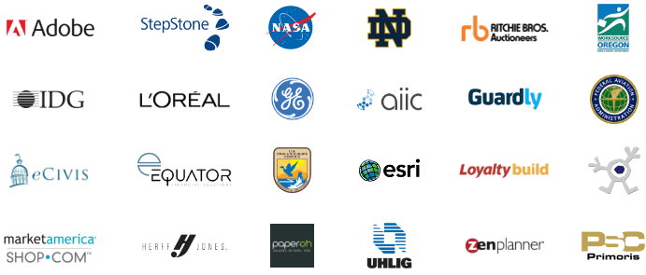
Core Products
ColdBox is a conventions-based MVC Framework. It provides a set of reusable code and tools that can be used to increase your development productivity, as well as a development standard for working in team environments. ColdBox is comprehensive and modular, which helps address most infrastructure concerns of typical CFML applications. It is composed of several standalone libraries that in turn compose the ColdBox Platform.
ColdBox powers scalable apps since 2005 with support and training.
www.coldbox.org

Slide 14
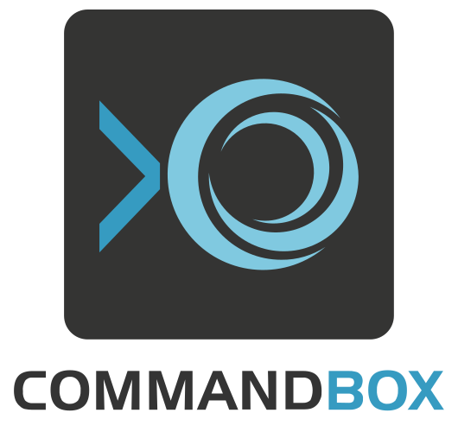
Core Products
A standalone, native tool for Windows, Mac, and Linux
CommandBox will provide you with a Command Line Interface (CLI) for developer productivity, tool interaction, package management, embedded CFML server, application scaffolding, and some sweet ASCII art.

Slide 15

Core Products
A powerful professional open-source headless CMS.
Designed to scale, perform with security in mind, and multi-site ready.

Slide 16

Core Products
Dynamic : Modular : Productive
A modern, dynamically and loosely typed scripting language for multiple runtimes.
For the Java Virtual Machine (JVM) giving you tons of Object-Oriented (OO), Functional Programming (FP) Constructs, and dynamic Metadata Programming (MP)

Slide 17







Core Products
Resellers

Slide 18
Services

Slide 19

Services
Custom Software Development
Our Skills
Software & Mobile App Developers
Need a website, API, mobile or application? We have all the tools and services to get your project built!
UI/UX Designers
Data Analysts
Business Analysts
Project Managers

Slide 20
Services
Custom Software Development
Our Skills
Infrastructure Architects
Need a website, API, mobile or application? We have all the tools and services to get your project built!
Software Testers
Security Auditors
DevOps Engineers
Software Architects

Slide 21


Services
UX/UI Design
Mobile App
We offer architecture & design services for your next big project.
Create fully-responsive websites, progressive apps and hybrid mobile apps.

Slide 22


Services
Legacy Modernization
Quality Assurance
Bring your Legacy Applications to the twenty-first century!
Test your application functionality, performance and security.

Slide 23


Services
Business
Inteligence
DevOps & Infrastructure
Centralize and automate data with a real-time BI dashboard to uncover insights, track KPIs, and enhance decision-making for your business.
Let us design your next server farm, CI/CD or fine tune it for optimal performance.

Slide 24


Services
Performance & Security
Expert
Training
Optimize performance for your apps, detect and remediate security vulnerabilities.
We have a wide selection of CFML training courses which can be delivered on-site or virtually.

Slide 25


Services
Staff Augmentation
Elasticsearch Solutions
Accelerate your Web Development Projects with On-Demand Software Development Experts!
Enhance search with expert consulting and implementation of Elasticsearch and AWS OpenSearch

Slide 26

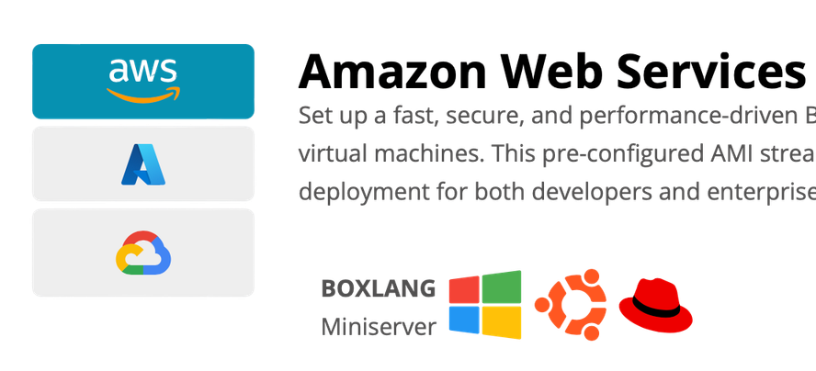

Services
Cloud Servers
Offers a seamless and high-performance Ubuntu and Windows-based environment to deploy and manage BoxLang applications on Microsoft Azure and AWS. This virtual machine is pre-configured with everything you need to start coding, deploying, and scaling your applications with ease.
a new way to the cloud
Amazon Web Services
Set up a fast, secure, and performance-driven BoxLang environment on AWS with our Ubuntu and Windows-based virtual machines. This pre-configured AMI streamlines development, offering seamless scalability and effortless cloud deployment for both developers and enterprises.
BOXLANG
Miniserver
BOXLANG
With CommandBox

Slide 27
Services
AI services
Smarter Software with AI Insight
Streamline workflows, automate tasks, and unlock insights with AI solutions tailored to your business.
OUR SIMPLE 3-STEP PLAN
1
Schedule a Discovery Call
Tell us about your challenges and goals so we can understand where AI can deliver real impact.
2
Get a Custom AI Strategy
We design a tailored plan that fits your workflows, data, and business priorities.
3
Build and Scale with Confidence
We implement intelligent solutions that grow with your needs — and support you every step of the way.

Slide 28

Services
Professional Support
Our support programs cover the following areas:
Online private ticketing system
Servicing our open-source community since 2006!
Development discounted rates
Priority patches & updates
Custom builds
Up to 20% off training discounts

Slide 29
Services
Professional Support
Our support programs cover the following areas:
Up to 20% off book discounts
Servicing our open-source community since 2006!
Up to 20% off Ortus commercial product
Custom modules
Phone/Online support by appointment only

Slide 30
Senior Software Architect
Software Architect
Labor Categories
Leads software innovation, designs web applications, supervises and mentors architects.
Designs enterprise software, web applications, and ensures seamless user experience.
Senior Web Developer
Web Developer
Leads full-stack development, creates, extends, maintains apps, supervises, and mentors.
Develops full-stack web apps, extends functionality, and maintains under supervision.
Available through the GSA.
SIN: 54151S
Junior Web Developer
UI/UX Designer
Codes front-end or back-end tasks, extends functionality, under senior guidance.
Designs web UX/UI for intuitive navigation under senior designer's supervision.

Slide 31
Junior UI/UX Designer
Senior DevOps Engineer
Labor Categories
Designs web UX/UI elements for intuitive navigation under senior guidance.
Leads DevOps, automates deployments, ensures reliability, supervises, and mentors engineers.
DevOps Engineer
Senior DBA
Automates testing, release, deployment of web apps under DevOps supervision.
Manages, implements, and maintains databases, ensuring efficiency and security.
Available through the GSA.
SIN: 54151S
Software Tester
Senior Project Manager
Tests software to detect defects and ensure high quality before release.
Leads, plans, executes software projects, oversees and supervises managers.

Slide 32
GSA Schedule Offering
SINs
54151S
Information Technology Professional Services
611420
Information Technology Training
GSA Contract Number
511210
Software Licenses
47QTCA23D00DH

Slide 33
SIN: 611420
Training
ColdBox Master Class On-site
CBElsatic Search On -site
ColdBox Master Class Virtual
CBElsatic Search Virtual
ColdBox Zero to Hero On-Site
Intro to COLDBOX On-site
ColdBox Zero to Hero Virtual
Intro to COLDBOX Virtual
ColdBox Hero to SuperHero On-site
Core COLDBOX On-site
ColdBox Hero to SuperHero Virtual
Core COLDBOX Virtual
ColdBox Zero to MegaHero: REST APIs + VueJS On-site P
COLDBOX Modules On-site
ColdBox Zero to MegaHero: REST APIs + VueJS Virtual
COLDBOX Modules Virtual

Slide 34
SIN: 611420
Training
WIREBOX Dependency Injection & AOP On-site
CONTENTBOX Modular CMS On-site
WIREBOX Dependency Injection & AOP Virtual
CONTENTBOX Modular CMS Virtual
BDD & TDD Development On-site
ColdFusion ORM On-site
BDD & TDD Development Virtual
ColdFusion ORM Virtual
COMMANDBOX Deep Dive On-site
Intro to Quick On-site
COMMANDBOX Deep Dive Virtual
Intro to Quick Virtual
COLDBOX RESTFul Services On-site
CFCASTS Subscription 1 Year
COLDBOX RESTFul Services Virtual
CFCASTS Subscription - 1 Month

Slide 35
SIN: 611420
Training
Containerizing ColdFusion (CFML) Apps On -site
Containerizing ColdFusion (CFML) Apps Virtual
Object Oriented Programming with CFML On-Site
Object Oriented Programming with CFML Virtual

Slide 36

SIN: 611420
Virtual training
Availabe on demand

Slide 37
Software Licenses
CommandBox Server Service Manager
A software module that can be installed to the CommandBox CLI tool that allows for the servers services to be managed from the command line.
SIN: 511210
LifeTime License

Slide 38
Software Licenses
FORGEBOX Enterprise
A software module that can be installed to the CommandBox CLI tool that allows for the servers services to be managed from the command line.
SIN: 511210
1 Year License
1 Month License

Slide 39
Software Licenses
FORGEBOX Business
A cloud based softwarepackages repository and software directory for ColdFusion applications with the ability to store private packages and manage teams.
SIN: 511210
1 Year License
1 Month License

Slide 40
Software Licenses
FORGEBOX Pro
A cloud based softwarepackages repository and software directory for ColdFusion applications with the ability to store private packages.
SIN: 511210
1 Year License
1 Month License

Slide 41
Software Licenses
CommandBox Pro
CommandBox Pro is a professionally supported version of CommandBox that includes exclusive features such as a Service Manager Module, Multi-server deployment in a single context and automatic JDK management.
SIN: 511210
1 Year License
1 Month License

Slide 42
511210 | SOFTWARE PUBLISHER
519130 | SOFTWARE PUBLISHERS & BROADCASTING & WEB SEARCH PORTALS
541330 | ENGINEERING SERVICES
541511 | CUSTOM COMPUTER PROGRAMMING SERVICES
541512 | COMPUTER SYSTEMS DESIGN SERVICES
541519 | INFORMATION TECHNOLOGY VALUE ADDED RESELLERS
NAICS

Slide 43
Past Performance

Slide 44

Past Performance
NEFB
Naval Expeditionary Forensics and Biometrics
Service/Technologies
Custom Development
ElasticSearch
Cloud Migrations
Security Hardening
Training
Software Architecture
Agile Team Management
ColdBox
CommandBox
REST APIs
Vue JS
MSSQL
Performance tuning
Web accessibility
Ortus Solutions has supported the Naval Expeditionary Forensics and Biometrics (NEFB) task order as a subcontractor since 2018. Since then, Ortus has led program efforts related to the WEAT web application development, testing and deployment.
Customer survey review:
“Performance met and exceeded scope/project expectations. Ortus went above and beyond in resolving critical issues in a timely manner and demonstrated capable leadership and project ownership.”

Slide 45

Past Performance
NASA
Ortus Solutions has supported NASA with on-site training and consulting for their web implementations using powered by Ortus software. Ortus has also trained them on modern web development architecture and methodologies such as behavior- and test-driven development (BDD + TDD), object-oriented design and MVC architecture.
Service/Technologies
Software Architecture
ColdBox
TextBox
CommandBox
Training

Slide 46

Past Performance
Department of Labor
Ortus Solutions has supported the Department of Labor with on-site training and support for ColdBox application development and MVC architecture.
Service/Technologies
Training
ColdBox
TextBox
CommandBox
Security hardening

Slide 47

Past Performance
Illinois Office of Comptroller
Ortus was in charge of migrating their main website and all its components to Ortus Open Source Content Management System: ContentBox CMS. The migration included a redesign of the IOC’s entire Software development life cycle, the introduction to agile methodologies for delivering code and the automation of deployments and tests.
Service/Technologies
ContentBox CMS
Custom Development
Infrastructure Development
DevOps

Slide 48

Past Performance
US Navy
Sole Source Acquisition to deliver new API and new modules, Weat LAB and Meestro for the WEAT 3.0 web application; developing transfer mechanisms for migrating data from the legacy system and deploying the app at Fort Gillem Atlanta, GA.
On-site Training of modern web development practices and technologies namely developing web application with a MVC design pattern and behavior-driven development
Service/Technologies
Custom module development

Slide 49

Past Performance
InFlow
Subcontracting on-site training to teach on MVC design pattern, enterprise architecture design, building RESTful API and software development best practices, for new U.S. Navy Dahlgren team members joining WEAT development efforts.
Service/Technologies
Training
Software Architecture

Slide 50

Past Performance
PAE
Subcontracting work for the delivery of various WEAT 3.0 components: ORM Design, UI Mockups, Security Framework, Modules Framework, and Site, Person, User and Admin modules.
Service/Technologies
Application Component Development
Custom Development

Slide 51

Past Performance
WorkSource Oregon
On-site training, help their development team learn and adopt modern web development practices and technologies, such as object-oriented programming and MVC architecture.
Security auditing of their web system and web applications servers’ performance analysis and optimization.
Service/Technologies
Training
ColdBox
TestBox
CommandBox
Software Architecture

Slide 52

Past Performance
esri
Design and implementation of a newer and more secured infrastructure with automated code deployment processes to host their back-office applications. Upgraded into latest software, configured integration settings and refactored deprecated code for 250+ web applications.
Service/Technologies
ColdBox
TestBox
CommandBox
Legacy Migration
Modernization
NGX
Couchbase

Slide 53

Past Performance
Central San
Migration of their existing web application used to manage their internal operations systems into a new development framework with its own automated testing suite, dependency injection and logging.
Service/Technologies
Modernization
ColdBox MVC Migration

Slide 54






































Our tools power Apps
Around the World!

Slide 55
Points of Contact
Cristobal Escobar
Jorge Reyes
Luis Majano
Business Development
COO
CEO
cristobal@ortussolutions.com
jreyes@ortussolutions.com
lmajano@ortussolutions.com

Slide 56

Thank You!
Presentation 2025

